Slide 1
ADAPTIVE MAPREDUCE SCHEDULING IN SHARED ENVIRONMENTS
PROJECT TEAM: PROJECT GUIDE:
Aadil Ahmed Adam - 1BI11CS001 Dr. S. Nandagopalan
Aishwarya B S -1BI11CS009 Head of the Department( CSE)
Deepa S -1BI11CS030
Bhavya Murthy N -1BI11CS134:

Slide 2
AGENDA
Introduction
Problem statement
Existing systems and Disadvantages
Proposed system and Advantages
Architecture Diagram
Layered Architecture
Use case diagram
Flow diagram
Modules breakdown
Pseudo code
Testing
Snapshots
Conclusion
Future advancements
References

Slide 3
INTRODUCTION
The industry and research community have witnessed an extraordinary growth in research and development of data-related technologies.
Instead of running the services in completely dedicated environments, It is becoming common to multiplex complementary workloads in the same machines.
This is turning clusters and data centres into shared environments.
“Big data” is used for large data sets whose size is beyond the ability of commonly used software tools to capture, manage, and process the data within a tolerable elapsed time.
Hadoop, which is an open-source framework allowing distributed computing for large data sets, is made of two components:
distributed file system component referred to as HDFS
MapReduce component

Slide 4
Hadoop provides a distributed file system (HDFS) that can store data across thousands of servers, and a means of running work (Map/Reduce jobs) across those machines, running the work near the data.
HDFS has a master/slave architecture. Large amount of data is automatically split into chunks which are managed by different nodes in the Hadoop cluster.
Map Reduce is a software framework introduced by Google in 2004 to support distributed computing on large data sets on clusters of computers.
We consider such an environment in which data analytics jobs, such as MapReduce applications, are collocated with transactional workloads.

Slide 5
PROBLEM STATEMENT
Analytics of large data sets (Big Data) with the help of a novel scheduler to extract useful report, managing the available resources .
Input: server logs, weather data, sample text
Output: report generated at the particular scheduled time

Slide 6
EXISTING SYSTEMS
RDBMS like MySQL, Oracle, Sybase etc are used for analytic purposes.
Job schedulers (planners) like cron, timers, quartz.
EXISTING SYSTEMS- Disadvantages
Difficulty in analyzing large data sets
One analysis report can be generated at any point of time by one instance
Existing planners can not be reused
Failed tasks remains failed, missed task
No User notification regarding the status of the analysis

Slide 7
PROPOSED SYSTEM
An efficient analytical engine developed using Hadoop Big data and Map reduce paradigm performing analysis.
A robust and customizable Analytical Planner engine accessible by different user roles
A pluggable and reusable helper component independent of either of the engines.
PROPOSED SYSTEM - Advantages
Less time taken during analysis
User notification
Reusable and Customizable Planner engine
An helper component independent of Analytical engine and Planner engine,
thus Pluggable to any engines
Asynchronous analytical call thus enabling multiple analytical operations possible at the same time

Slide 8
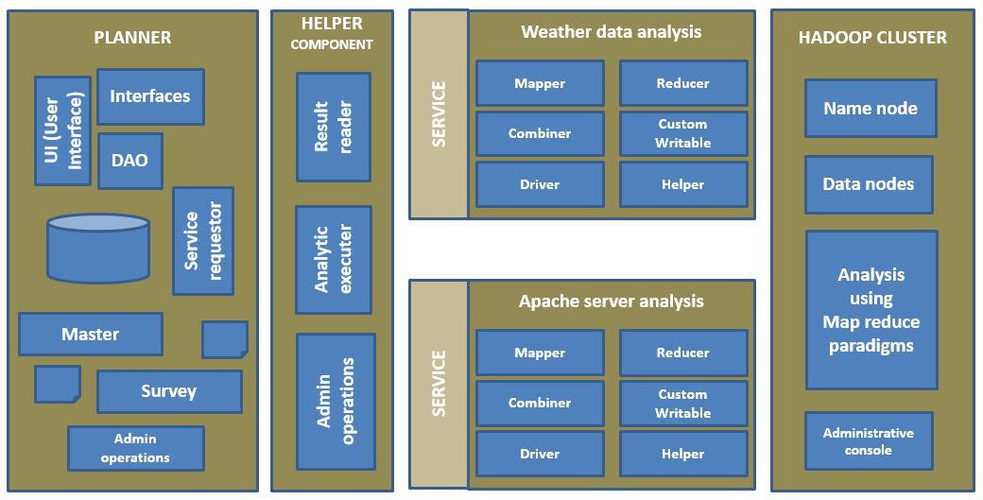
ARCHITECTURE

Slide 9




Layered Architecture
CLIENT
TIER
FOUNDATION
JQUERY
UI KIT
BUSINESS LOGIC TIER
SERVLETS
HELPERS
INTERFACES
UTILS
DAOs and POJOs
HELPER COMPONENT
HADOOP LAYER
MAPPER
REDUCER
DRIVER
DATABASE
TIER
JOB DETAILS
USER DETAILS

Slide 10
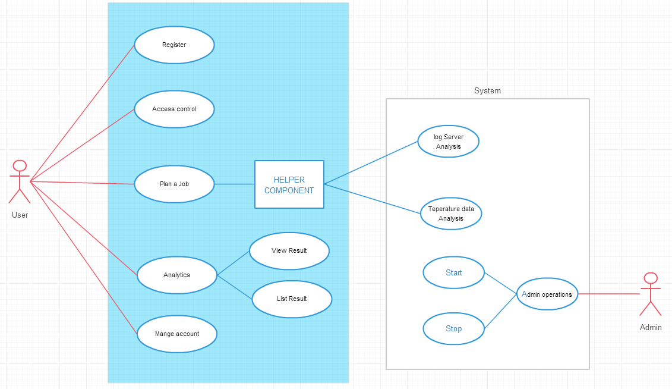
USE-CASE DIAGRAM

Slide 11
FLOW DIAGRAM
USER
AUTHENTICATE
LOGIN
PLAN
SEND
INSERT
MENU
PLANNER
WC
NAME
NODE
EXE
HADOOP
COMMAND
INDEXING
REMOVE
MAP REDUCE
VIEW LIST
VIEW FILE
DATA NODE
VIEW LIST

Slide 12
MODULES BREAKDOWN
Module 1: Hadoop cluster containing Map reduce paradigm
Module 2: Apache logs analysis
Module 3: Weather data analysis
Module 4: Helper component
Module 5: Planner interface
Module 6: Data access - Planner

Slide 13
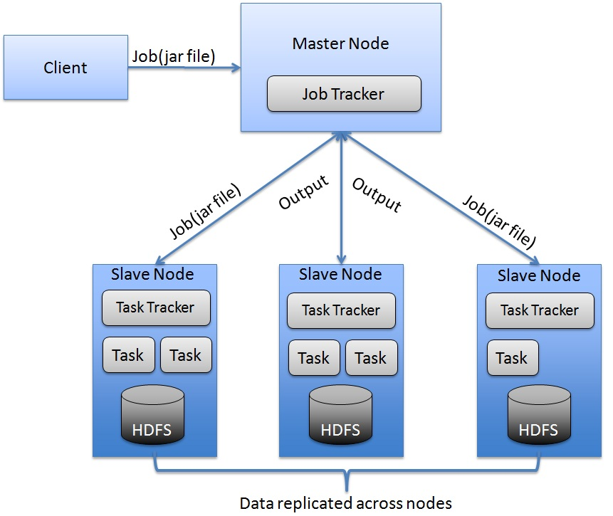
MODULE 1: Hadoop cluster with MapReduce paradigm
HADOOP CLUSTER

Slide 14
MapReduce paradigm
MapReduce is basically a framework made to process large amounts of data in parallel by breaking the input into multiple independents splits.
A program written under the MapReduce framework should operate in two phases called “map” and “reduce”.
As far as Hadoop is concerned, the MapReduce job splits the inputs and then makes use of the “map” phase to process splits in parallel; so each map task works on its share of the input without worrying about the rest of the map tasks.
After that, the framework itself uses a sorter to rank the map outputs before passing them to the reduce tasks that merges them.

Slide 15
MODULE 2: Apache log analysis
Apache log is a file which contains the log activities of a particular website.
Usually the apache log file is evaluated when it is in a jar file.
The activity log contains the IP address, date of visiting the address, time and the URL of the website.

Slide 16
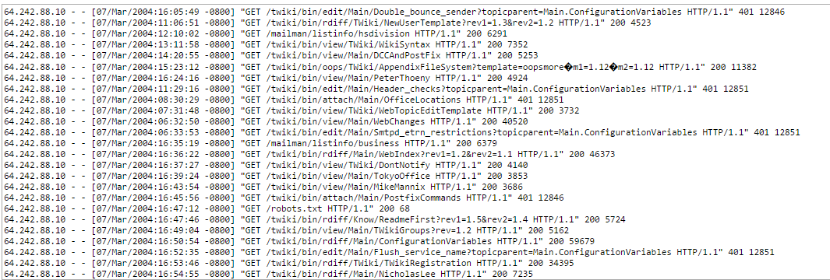
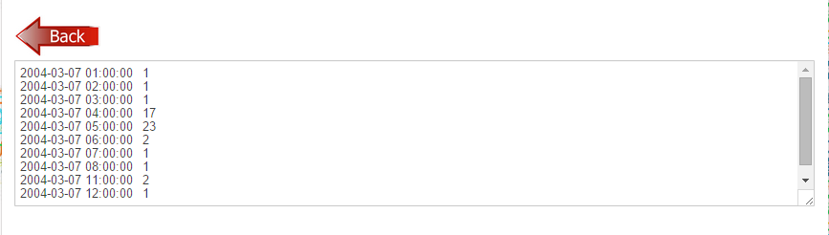
Input: Sample data for log analysis
Output:

Slide 17
MODULE 3 : Weather data analysis
Weather data is a file which activities the weather conditions during a certain period of time in a particular region or city.
The weather data can be evaluated only when it is in jar file.
The weather data contains the region, temperature, date and time.

Slide 18
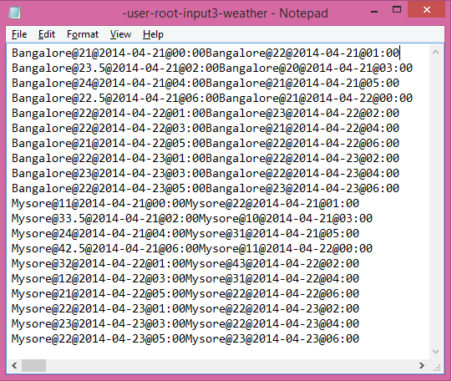
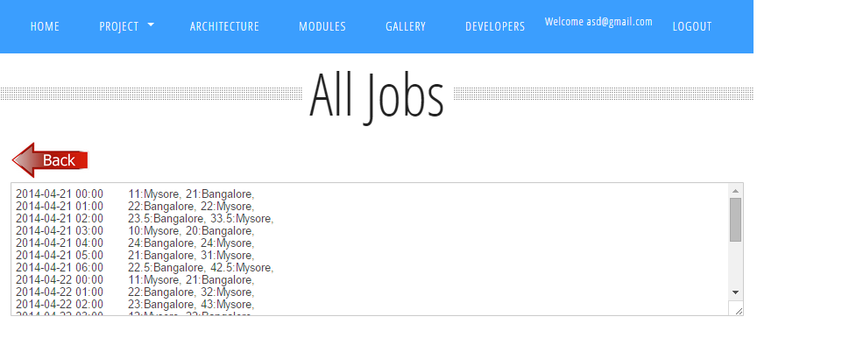
Input:
Output:

Slide 19
MODULE 4: Helper component
The Helper component is the one responsible for the communication between the planner and the Hadoop.
It acts as a mediator for the exchange of data.
The Helper component consists of 2 parts:
Admin operations
Analytic executer
Admin operations is used for scheduling the jobs in the planner interface.
It takes the input from the user and connects to the database.
It invokes the master and the survey planner in order to carry out the scheduled job.
The Hadoop cluster carries out the necessary steps in order to consolidate the data i.e. weather data or log analysis.
At last, the Analytic executer takes the resultant of the Hadoop cluster and forms an analytic path.
It creates a separate output file in order to prevent from the data from duplication.

Slide 20
MODULE 5: Planner interface
Database: contains the details of the scheduled jobs entered by user.
Master: is used to process the scheduled jobs which executes continuously every 3 seconds to keep track of new jobs.
Survey: will also executes but every 6 sec to track failed and missed jobs.
After fetching data jobs by master and server they make use of service request.
Service requestor: will use helper component i.e, analytical executer, to execute jobs such as weather data and server logs.
Result reader: The results of these analysis will be send back the another helper component result reader which in turn send the report back to service requestor.
Data access : DAO operations, it contains methods such as read ,write, update, etc since it cannot be directly accessed we will make use of interface
UI [user interface]: this interface is for the user to give input and get the output.

Slide 21
MODULE 6: Data-access interface
Data access interface for having a secure input path.
Initially the user is logged in to have an authorized permission.
The input path of the scheduled job is initialized so that the interface can directly connect to the path provided by the user.

Slide 22
PSEUDO CODE
Mapper component
1. map(LongWritable inputKey, Text inputValue,
OutputCollector<Text, IntWritable> output, Reporter report)
2. Convert the entire line from Mapreduce representation to Java String representation
openBracket <- line.indexOf('[');
closeBracket <- line.indexOf(']');
3. if (openBracket != -1 && closeBracket != -1) {dateString <- line.substring(line.indexOf('[') + 1, line.indexOf(']'));
SimpleDateFormat sdf <- new SimpleDateFormat("dd/MMM/yyyy:hh:mm:ss");
Calendar <- dateString
time <- sdf2.format(c.getTime());
4. output.collect(time, 1));

Slide 23
reducer component
1. reduce(Text inputKey, Iterator<IntWritable> inputValues, OutputCollector<Text, IntWritable> output, Reporter report)
i<-0
2. while (inputValues.hasNext()) {
i++;
inputValues.next();
3. output.collect(inputKey, new IntWritable(i));

Slide 24
TESTING

Slide 25
Steps | Test Action | Results
Step 1 | Enter http://localhost:8080/Planner on hadoop cluster to check of the planner layer is up and running or not | The planner layer loaded successfully
Step 2 | Execute: hadoop namenode –format to format the namenode | Namenode got formatted
Step 3 | Execute: hadoop datanode –format to format the datanode | Datanode got formatted
Step 4 | Execute: hadoop namenode to start the namenode | Namenode started successfully
Step 5 | Execute: hadoop datanode to start the datanode | Datanode started successfully
Step 6 | Click on Register and fill the form and hit enter | Successfully registered
Step 7 | Click on Login and fill the form and hit enter | Successfully able to login to the Planner application
Step 8 | Click on PLAN A JOB and fill the form and hit enter | Job created successfully
Step 9 | Click on various links on the project to see if the links are broken or working finr | All links appears to be working fine
Step 10 | Click on various features on the front end interface. | All features are tested and works fine

Slide 26

SNAPSHOTS

Slide 27


Slide 28


Slide 29
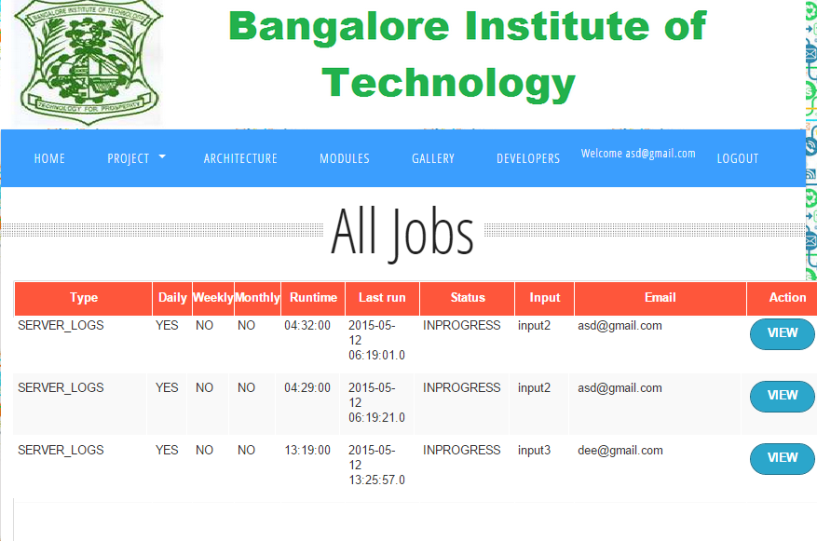

Slide 30
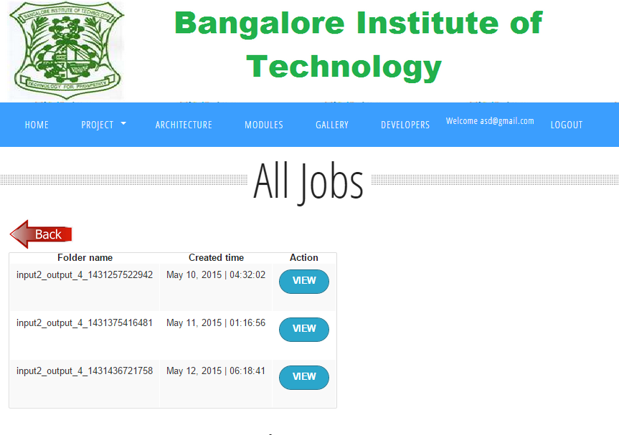

Slide 31
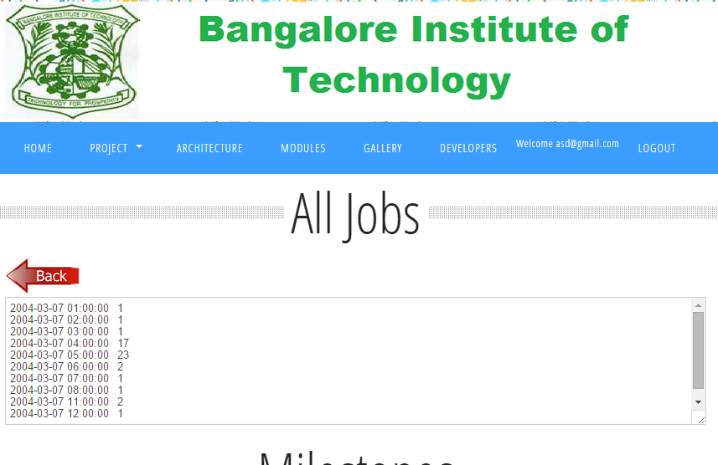

Slide 32
APPLICATIONS
The pluggable components of this project can be used by any organization to analyze their large data sets in an efficient manner rather than the manual analysis which is time consuming and not fault-tolerant.
E.gs:
Health care systems in detecting the number of people suffering from a particular disease.
College server admins can use it to for analyzing the server logs.
Social networking sites- analysis of tweets etc..

Slide 33
CONCLUSION
In this project, we have explored the solution to big data problem using
Hadoop data cluster, HDFS and Map Reduce programming framework using big data prototype application scenarios. The results obtained from various experiments indicate the favorable results of the above approach to address big data problem.

Slide 34
FUTURE ENHANCEMENTS
Future work will focus on performance evaluation and modeling of Hadoop data-intensive applications on cloud platforms like Amazon Elastic Compute Cloud (EC2).

Slide 35
REFERENCES
J. Dean and S. Ghemawat, “MapReduce: Simplified data processing on large clusters,” in OSDI’04: Proceedings of the 6th Symposium on Operating Systems Design and Implementation. San Francisco, CA: USENIX Association
D. Gmach, J. Rolia, L. Cherkasova, and A. Kemper, “Workload analysis and demand prediction of enterprise data center applications,” in Workload Characterization, 2007. IISWC 2007. IEEE 10th International Symposium on.
G. DeCandia, D. Hastorun, M. Jampani, G. Kakulapati, A. Lakshman,A. Pilchin, S. Sivasubramanian, P. Vosshall, and W. Vogels, “Dynamo:amazon’s highly available key-value store,” in Proceedings of twentyfirst ACM SIGOPS symposium on Operating systems principles, ser. SOSP ’07. NY, USA: ACM, 2007, pp. 205–220.

Slide 36

THANK
YOU…

